Slide 1
Square & Triangular Wave Generator
Yousef AlAbdulrazzaq 75018
Hamad AlAjmi 10081835
Mohammad AlDosari 74123

Slide 2
Abstract
Generate square and triangular waveforms using LM371 op-amps
Show that integrating a square wave results in a triangular wave
Design a working prototype and verify through simulation

Slide 3
Theory (Square Wave)
Power on → Output goes to +Vcc
C1 charges through R1
C1 voltage exceeds threshold → Output flips to –Vcc
C1 discharges
C1 drops below negative threshold → Output flips to +Vcc
Cycle repeats producing square waveform
[1]

Slide 4
Theory (Integrator)
Square wave input through R4
Operation:
Constant positive input → Output ramps down linearly
Constant negative input → Output ramps up linearly
Alternating +/- from square wave creates triangular wave

Slide 5
Criteria & Constraints
Criteria:
Generate stable square waveform
Integrate square wave into triangular waveform
Only use op-amps and passive components
Constraints:
Circuit does not have external input
Use of standard RC components

Slide 6
Block Diagram
U1
Square Wave Generator
U2
Integrator
∫
Square Waveform
Triangular Waveform

Slide 7
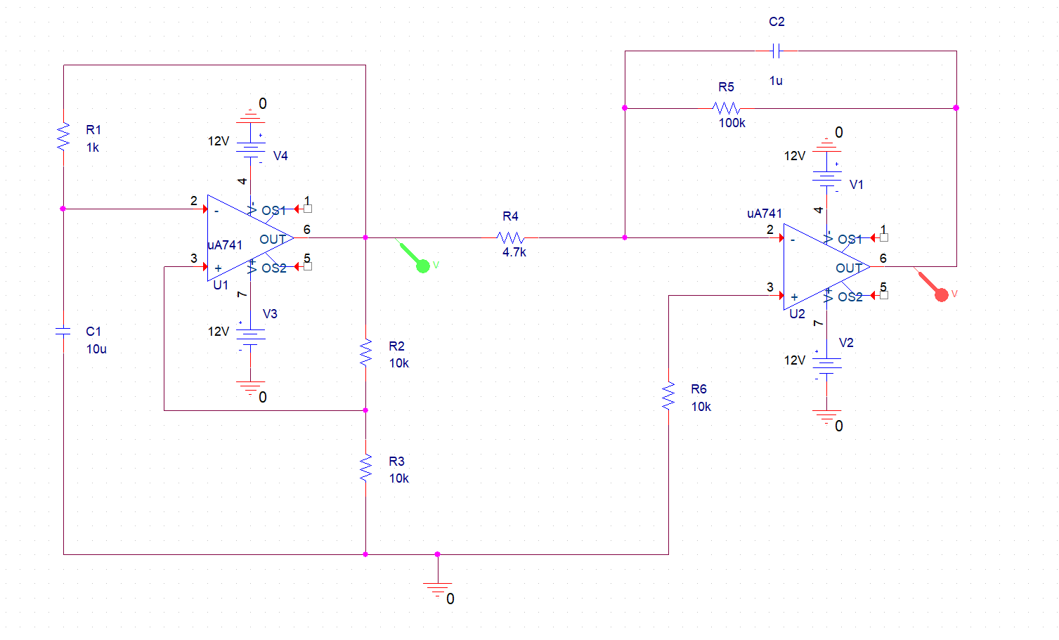
R1 would be a 10kΩ potentiometer

Slide 8
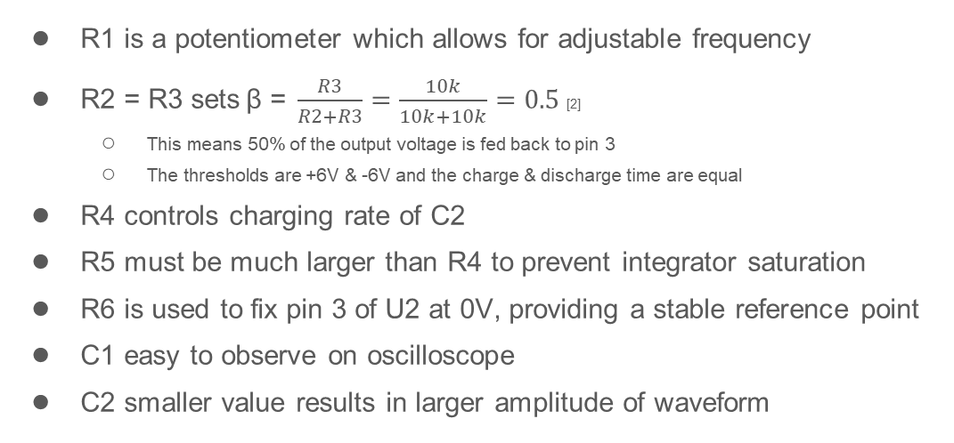
Component Justification
R1 is a potentiometer which allows for adjustable frequency
R2 = R3 sets$\text{β}\text{ = }\frac{R3}{R2+R3}=\frac{10k}{10k+10k}=0.5$[2]
This means 50% of the output voltage is fed back to pin 3
The thresholds are +6V & -6V and the charge & discharge time are equal
R4 controls charging rate of C2
R5 must be much larger than R4 to prevent integrator saturation
R6 is used to fix pin 3 of U2 at 0V, providing a stable reference point
C1 easy to observe on oscilloscope
C2 smaller value results in larger amplitude of waveform

Slide 9
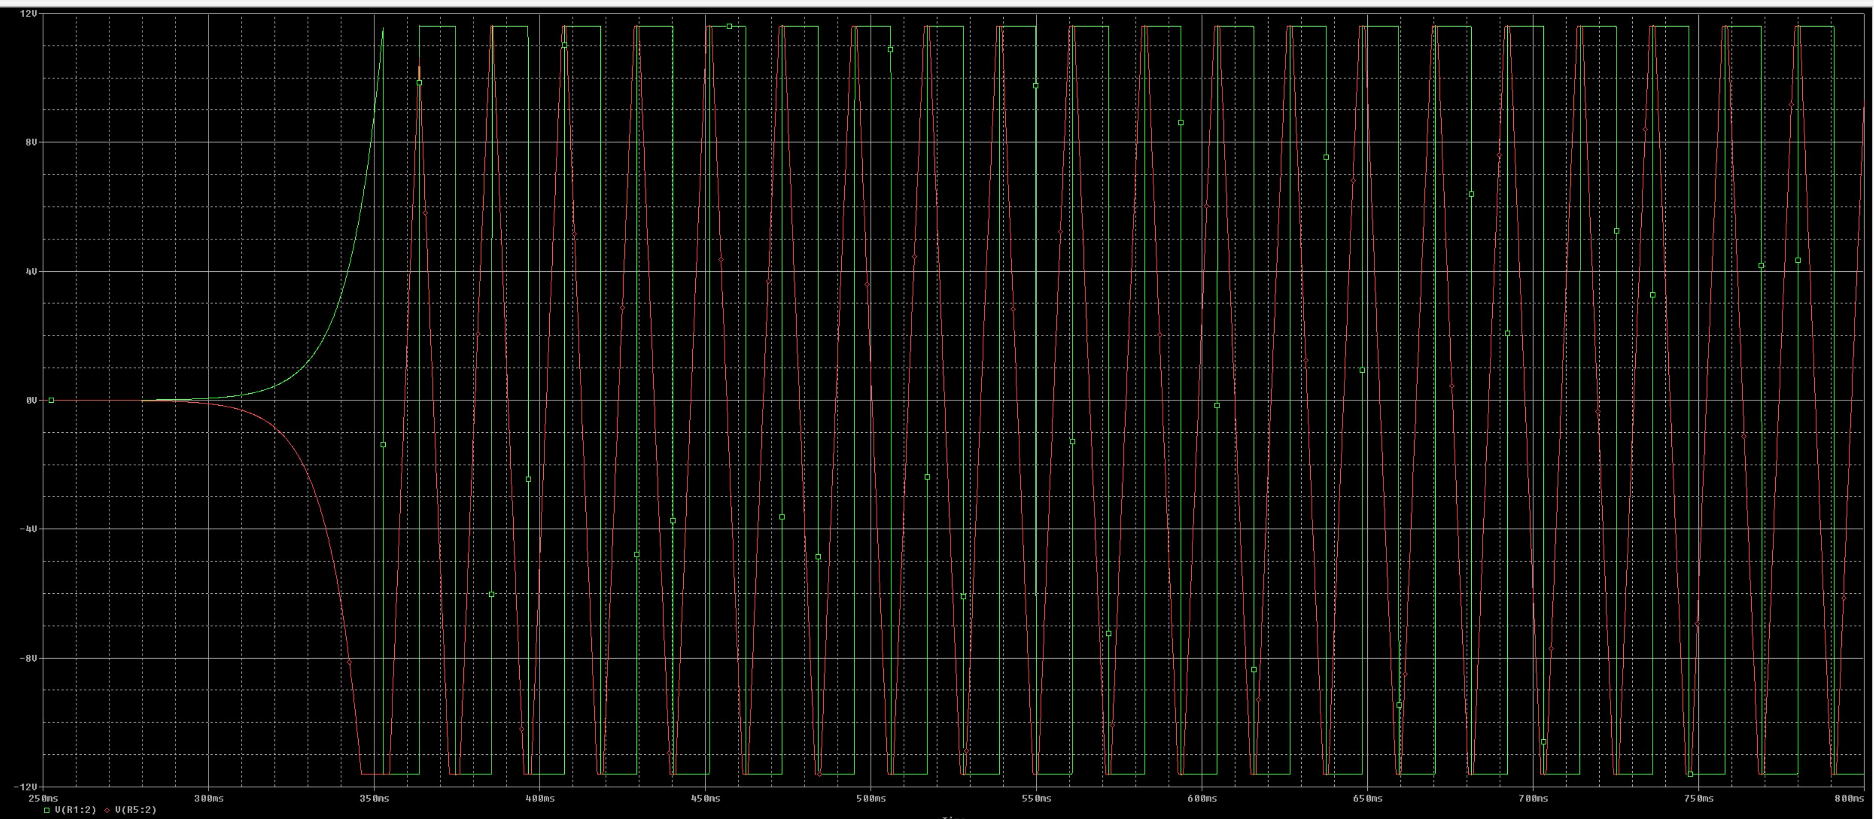
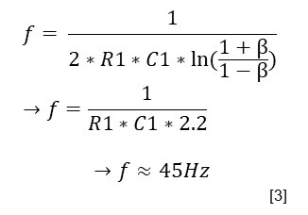
Expected Results
$$f= \frac{1}{2∗R1∗C1∗ln⁡(\frac{1+β}{1−β})} →f=\frac{1}{R1∗C1∗2.2}$$
$$→f≈45Hz$$
[3]
If R1 is set to 1kΩ, the resultant frequency for both waveforms will be about 45Hz
The amplitude of both waveforms will be about ±11V
Saturation voltage is slightly less than ±12V supply
The waveforms’ rise and
fall time should be equal

Slide 10
Conclusion
Successfully generated a square waveform
Correctly integrated the square wave into a triangular waveform
Designed a stable and simple circuit ready for prototyping

Slide 11
References
[1] Tutorialspoint, "Linear Integrated Circuits Applications - Waveform Generators," Tutorialspoint, 2024. [Online]. Available: https://www.tutorialspoint.com/linear_integrated_circuits_applications/linear_integrated_circuits_applications_waveform_generators.htm.
[2] AspenCore, Inc., "Negative Feedback Systems," Electronics Tutorials, 2024. [Online]. Available: https://www.electronics-tutorials.ws/systems/negative-feedback.html.
[3] AspenCore, Inc., "Op-amp Multivibrator," Electronics Tutorials, 2024. [Online]. Available: https://www.electronics-tutorials.ws/opamp/op-amp-multivibrator.html.

